Slide 1

ASUNCION RACE PREVIEW
Elite Analysis · August 4 – 9, 2026
USA Triathlon High Performance

Slide 2
Race Week Schedule
Asuncion
August 4 – 9, 2026 • La Isla del Delta, Nueva Asunción (guide states UTC-4; verify — Paraguay moved to permanent UTC-3 in 2024)
Tue-Fri • Aug 4-7
Sat • Aug 8
Sun • Aug 9
Sun • Aug 9
Non-Official Training
Familiarization & Briefing
ELITE WOMEN — STANDARD
ELITE MEN — STANDARD
07:00 – 11:00 | Swim — COP Olympic Aquatic Centre
14:00 – 16:00 | Run — COP Athletics Track
(any time) | Bike/run — Costanera Norte is the only recommended road option
— | ⚠ Race venue CLOSED all week: no course access until Saturday
07:00 – 07:15 | Call time at Hotel Esplendor
08:35 – 08:40 | Departure from hotel → arrive El Delta 09:20-09:30
10:00 – 10:30 | Bike course familiarization (closed circuit)
10:45 – 11:30 | Swim course familiarization (marked area)
13:40 – 13:50 | Departure from venue → arrive hotel 14:45-14:55
16:00 – 17:00 | ★ Mandatory Athlete Briefing — COP
04:30 | Call time at Hotel Esplendor (Women)
05:30 | Departure from hotel → arrive El Delta 06:00
06:00 – 06:45 | Athletes' Lounge opens — check-in
06:10 – 07:00 | Transition area check-in
06:45 – 07:15 | Swim warm-up
07:20 | Athletes' introduction
07:30 | ★ ELITE WOMEN START — 1500 / 40 / 10
~09:30 | Projected finish
06:35 | Call time at Hotel Esplendor (Men)
07:50 – 07:55 | Departure from hotel → arrive El Delta 08:00-08:20
09:00 – 09:45 | Athletes' Lounge opens — check-in
09:10 – 10:00 | Transition area check-in
09:45 – 10:15 | Swim warm-up
10:20 | Athletes' introduction
10:30 | ★ ELITE MEN START — 1500 / 40 / 10
12:30 | Award ceremony — Elite Women & Elite Men
Times La Isla del Delta, Nueva Asunción (guide states UTC-4; verify — Paraguay moved to permanent UTC-3 in 2024). Schedule confirmed from World Triathlon race-info page / athlete guide; subject to organiser updates.

Slide 3
Key Course Differentiators
Asuncion
ASUNCION
COURSE AT A GLANCE
The 2026 World Triathlon Cup Asunción is the first World Triathlon elite race ever staged at this venue, and Paraguay's first World Cup. It runs on La Isla del Delta in Nueva Asunción, across the Héroes del Chaco bridge from the capital. Two things make it unusual on the 2026 calendar. First, it is a STANDARD-distance World Cup (1500 m / 40 km / 10 km). Second, the course is flat in all three disciplines, on a closed avenue with long straights and few turns, suggesting an opportunity for a large intact bike pack and a run-off finish.
Swim:
1.5 km – 2 laps × 750 m
Bike:
39.96 km – 6 laps × 6.66 km
Run:
10 km – 4 laps × 2.35 km
Format:
Standard Distance (World Cup)
Bike Laps:
6
Run Laps:
4
COURSE FEATURES
QUICK LINKS
• STANDARD distance (1500 m / 40 km / 10 km).
Current Race Info:
• Flat across all three legs: 2 × 750 m lagoon swim, 6 × 6.66 km closed-avenue bike, 4 × 2.35 km + 600 m run.
Race Info | 2026 World Triathlon Cup Asunción
• Unclear wetsuit determination: 18–22 °C forecast.
• August is Paraguayan winter. Cool morning starts (Women 07:30, Men 10:30), Cold-weather warm-up kit likely more important than cooling kit.

Slide 4
Course Profile & Map
Asuncion
No Street View Available.

Slide 5
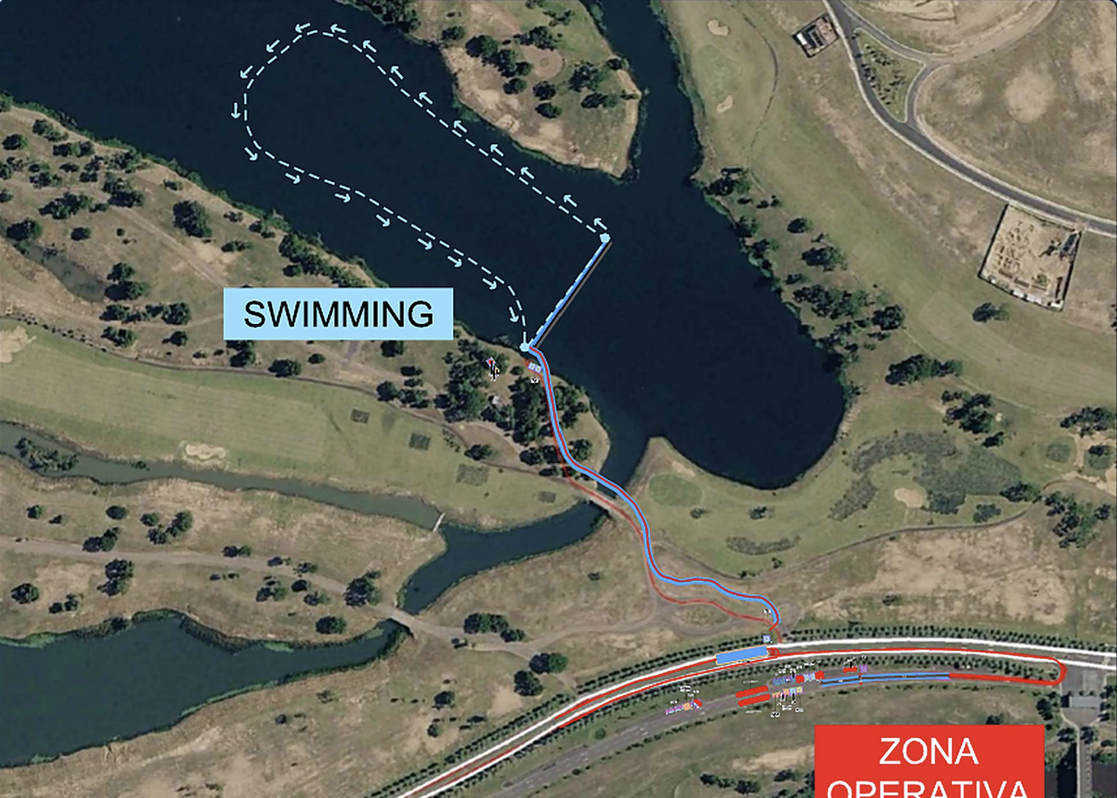
Swim Course Profile
Asuncion
1.5 km • 2 × 750 m
Sheltered inland lagoon — fresh water, calm
Distance
Layout
Start
1.5 km
Delta lagoon
Floating pontoon
Water Temp
Wetsuit
Lap Count
18.0–22.0 °C
Race Day
2
Tactical Notes
• Standard-distance swim: 2 × 750 m loops in the Delta lagoon. Not the Paraguay River should be sheltered with little to no current
• In-water start from floating Candock platforms
Source: 2026 World Triathlon Cup Asunción Athlete's Guide + official swimming course flyer — 9 Aug 2026
• Wetsuit call is TBD: 18–22 °C forecast leave wide range
• Swim familiarization is Saturday 10:45–11:30 only. The venue is closed to athletes on all other days
Not in race brief: Buoy count and turn configuration (not published in the guide)

Slide 6
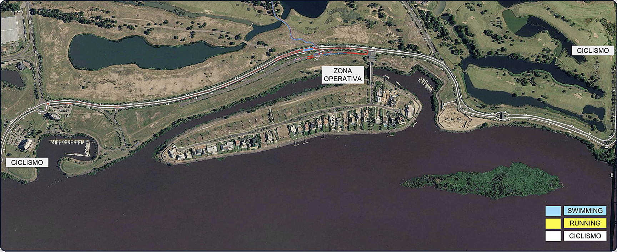
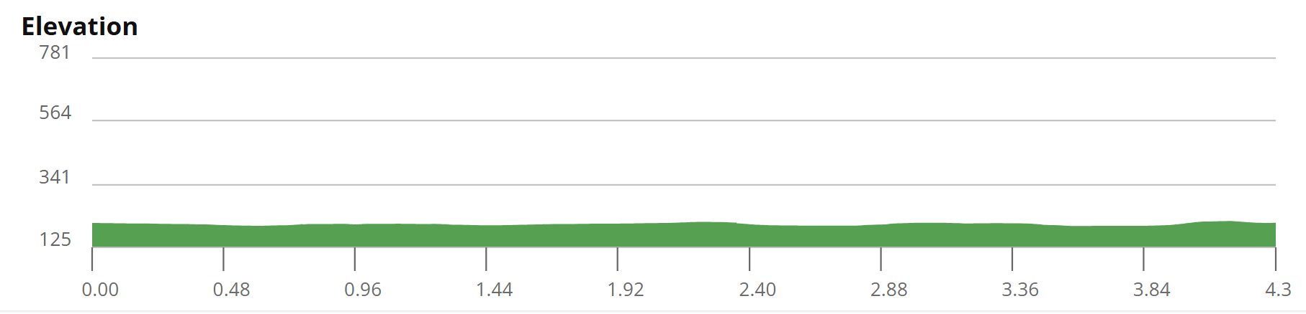
Bike Course Profile
Asuncion
39.96 km • 6 × 6.66 km loops
Closed avenue on La Isla del Delta — smooth tarmac, traffic-free
Elevation / Lap
Total Climb
Avg Grade
47 ft / lap
382 ft
0%
Max Climb Grade
Wind
Loops
1-2%
Potential Exposure
6 × 6.66 km
Tactical Implications
• 6 × 6.66 km laps = 39.96 km on a closed main avenue through the Delta development
• Flat throughout, with a long out-and-back shape with the Zona Operativa (transition) mid-course; few technical features beyond the end turnarounds.
• Open floodplain with minimal tree cover: Maybe some potential for crosswind exposure

Slide 7
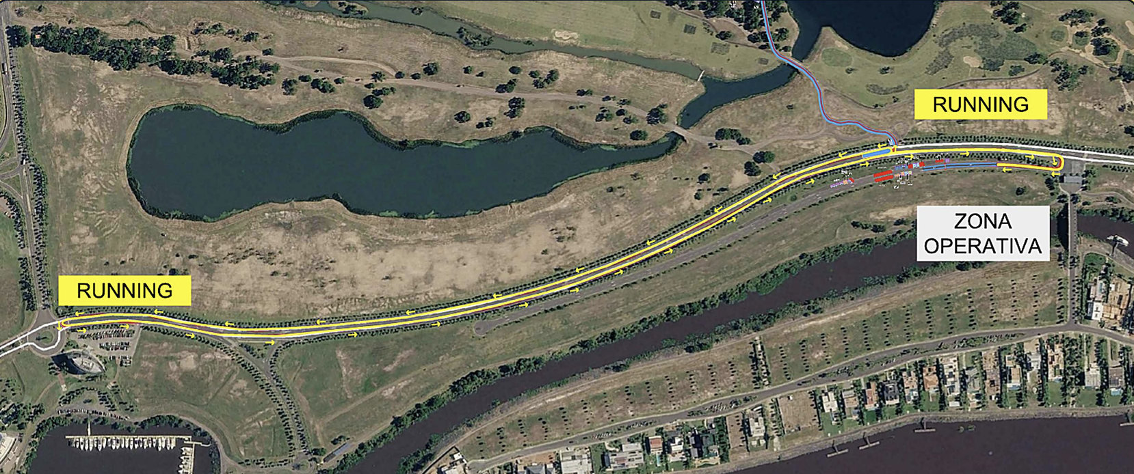
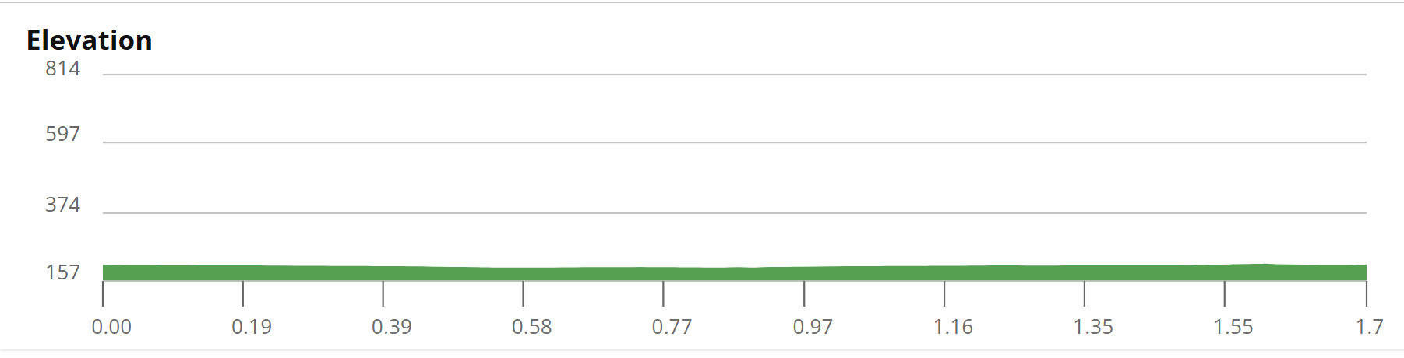
Run Course Profile
Asuncion
10.0 km • 4 × 2.4 km
Paved closed avenue alongside the lagoon and river frontage
Distance
Lap Structure
Total Climb
10.0 km
4 × 2.4 km
~ 60ft
Avg Grade
Max ▲ / ▼
Heat Risk
~0%
0-2%
LOW
Tactical Notes
• 4 × 2.35 km laps plus a final 600 m spur = 10 km.
• Long straight out-and-back shape along the avenue. Very few turns.
• August is winter here: both races run in the cool morning and finish by ~12:20, well before the daily maximum. Heat is not the limiter here

Slide 8
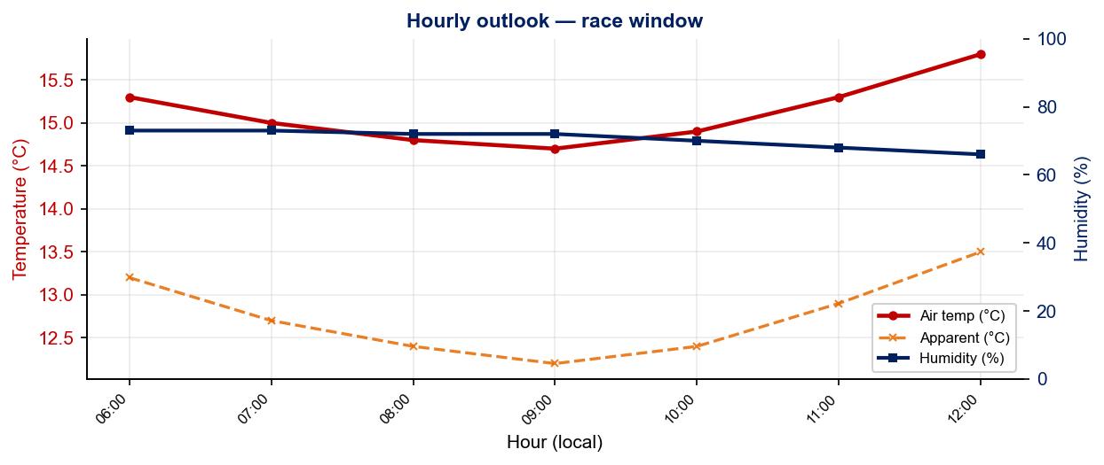
Race-Day Weather Outlook
Asuncion
2026-08-09 • Forward forecast — Open-Meteo (≤16 days)
Elite Women — 07:30
Temperature
Apparent / Heat
Humidity
14.8 °C
12.4 °C
72%
Wind
UV peak
Heat Stress
16.1 km/h
0.9
LOW
Elite Men — 10:30
Temperature
Apparent / Heat
Humidity
15.3 °C
12.9 °C
68%
Wind
UV peak
Heat Stress
15.3 km/h
4.6
LOW
Hydration & Cooling Cues
• Cool to mild outlook. No special pre-cooling required
• Notable wind (16 km/h) with some exposed coastal bike sections.
• Cold air pre-race. Wetsuit decision likely will be mandatory if water tracks the same direction
Data source: Open-Meteo. Forecast refreshes every run. Historical Race Conditions slide shows what actually happened in prior years.

Slide 9
Who to Watch — Asuncion Race Week
ELITE MEN
ELITE WOMEN
Top 10 Ranked on Startlist
Top 10 Ranked on Startlist
Rank | Athlete | Points
20 | Reese Vannerson | 2,911
37 | Jawad Abdelmoula | 2,532
40 | Mathis Beaulieu | 2,488
42 | Braxton Legg | 2,442
53 | Sullivan Middaugh | 2,234
61 | Liam Donnelly | 2,032
66 | Andree Buc | 1,955
69 | Kazushi Jozuka | 1,917
71 | James Corbett | 1,885
72 | Keller Norland | 1,863
Rank | Athlete | Points
30 | Verena Steinhauser | 2,627
31 | Manami Hayashi | 2,572
34 | Zuzana Michalickova | 2,443
38 | Danielle Orie | 2,432
43 | Beatrice Mallozzi | 2,267
44 | Mariana Vargem | 2,210
47 | Kelly Wetteland | 2,109
50 | Angelica Prestia | 2,091
59 | Mako Hiraizumi | 1,998
64 | Shanae Williams | 1,916
Returning Podium Athletes on Startlist
Returning Podium Athletes on Startlist
No prior race history at this venue.
No prior race history at this venue.
Rankings = current World Triathlon rankings snapshot; startlist intersect uses program_entries when available.

Slide 10
Top Swim Threats
Asuncion
Ranked by Lead Pack % (within 15 s of swim leader — robust to course speed) • EWMA swim split (span-5) shown per distance; Sprint = this race • WTCS / World Cup / Continental, last 4 yrs
ELITE MEN
ELITE WOMEN
# | Athlete | Lead % | EWMA Spr ▸ | EWMA Std | Spr/Std
1 | Aiden Longcroft-Harris | 96% | 9:32 | 17:51 | 15/8
2 | Ramón Armando Matute | 95% | 9:12 | 18:27 | 16/5
3 | Pietro Giovannini | 92% | 8:49 | 17:59 | 8/5
4 | Dylan McCullough | 85% | 8:30 | 17:25 | 13/7
5 | Kevin Tarek Viñuela Gonzalez | 74% | 9:07 | 17:04 | 14/13
6 | Filip Vilenica | 67% | 9:11 | — | 3/0
7 | Martin Demuth | 64% | 9:07 | 17:15 | 16/12
8 | Gabriel Terán Carvajal | 64% | 8:57 | 18:40 | 19/6
9 | Braxton Legg | 64% | 8:53 | 18:46 | 10/1
10 | Kauê Willy | 57% | 9:19 | 18:32 | 17/6
11 | James Corbett | 56% | 9:03 | 18:04 | 17/8
12 | Dylan Didier Campa Carranza | 55% | 9:07 | 16:41 | 18/4
13 | Badr Siwane | 54% | 10:52 | 18:22 | 20/8
14 | Tyler Smith | 47% | 9:30 | 17:41 | 12/7
# | Athlete | Lead % | EWMA Spr ▸ | EWMA Std | Spr/Std
1 | Kelly Wetteland | 80% | 9:53 | — | 5/0
2 | Cecilia Santamaria Surroca | 74% | 9:52 | 18:55 | 16/7
3 | Rosa Elena Martinez Melchior | 61% | 10:08 | 20:33 | 17/11
4 | Hollie Elliott | 55% | 9:44 | 19:19 | 14/6
5 | Moira Miranda | 53% | 10:06 | 19:46 | 13/4
6 | Tjasa Vrtacic | 50% | 9:56 | 19:03 | 12/2
7 | Danielle Orie | 44% | 9:45 | 19:55 | 12/4
8 | Josephine Seerig | 43% | 10:36 | 20:05 | 11/3
9 | Luisa Daniela Baca Vargas | 43% | 10:38 | 19:48 | 9/5
10 | Melanie Santos | 42% | 10:04 | 19:08 | 9/10
11 | Manami Hayashi | 42% | 9:56 | 20:06 | 17/7
12 | Ivana Kuriackova | 38% | 10:13 | 20:26 | 9/17
13 | Cecilia Perez | 38% | 10:31 | 19:36 | 16/5
14 | Maria De Los Angeles Bonilla Garcia | 36% | 10:22 | — | 11/0

Slide 11
USA World Rankings Snapshot
Asuncion
As of 2026-08-03 • World Triathlon Rankings • Heading into Asuncion • Race tier: World Cup
Max Points Available at this Race
Win
Podium
Top 5
Top 10
Top 15
Top 20
500 pts
427 pts
366 pts
247 pts
167 pts
113 pts
ELITE MEN
ELITE WOMEN
Rank | Athlete | Points | Curr | Prev
20 | Reese Vannerson | 2,911 | 6 | 6
21 | John Reed | 2,898 | 6 | 6
27 | Morgan Pearson | 2,680 | 5 | 4
42 | Braxton Legg | 2,442 | 6 | 6
52 | Seth Rider | 2,243 | 6 | 4
53 | Sullivan Middaugh | 2,234 | 6 | 6
72 | Keller Norland | 1,863 | 6 | 6
77 | Blake Bullard | 1,761 | 6 | 6
82 | Chase McQueen | 1,708 | 6 | 6
107 | Porter Middaugh | 1,494 | 6 | 6
112 | Darr Smith | 1,452 | 6 | 6
116 | Zach Leachman | 1,433 | 6 | —
173 | Carter Stuhlmacher | 1,041 | 6 | 4
280 | Cole Jamieson | 600 | 4 | 2
381 | Isaac Lamprecht | 375 | 6 | 2
Rank | Athlete | Points | Curr | Prev
9 | Taylor Spivey | 5,091 | 6 | 3
16 | Gina Sereno | 3,205 | 6 | 6
26 | Gwen Jorgensen | 2,700 | 6 | 6
38 | Danielle Orie | 2,432 | 6 | 6
40 | Erika Ackerlund | 2,341 | 6 | 6
47 | Kelly Wetteland | 2,109 | 6 | 3
52 | Taylor Knibb | 2,047 | 4 | —
60 | Naomi Ruff | 1,997 | 6 | 6
86 | Kirsten Kasper | 1,551 | 5 | 2
87 | Joy Gill | 1,547 | 6 | 5
88 | Eleanor Beveridge | 1,544 | 6 | 6
113 | Rachel Werking | 1,302 | 6 | 2
124 | Michelle Magnani | 1,242 | 6 | 6
159 | Katie McCune | 1,042 | 6 | 1
165 | Ellison Wolfe | 1,002 | 6 | 4

Slide 12
Olympic Qualification Pace
Asuncion
Paris 2024 OQR cutoff (30th): 3,626.69 pts ÷ 12-event cap = 302 pts / event on pace
An athlete who averages ~302 pts per event across their best 12 events is on pace to clear the LA 2028 qualifying threshold.
FINISH POSITION AT EACH TIER THAT HITS 302-PT PACE
Tier | Win pts | Last on-pace pos | First off-pace pos (pts) | Verdict
World Championship Series | 1000 | #16 | #17 (287 pts) | Top 16
World Cup | 500 | #7 | #8 (290 pts) | Top 7
USA MEN
USA WOMEN
Rk | Athlete | Total | Races | On | Off | Pace | Proj @12
13 | Reese Vannerson | 1,479 | 4 | 3 | 1 | 369 | 4,439
16 | Seth Rider | 1,341 | 4 | 3 | 1 | 335 | 4,023
17 | Sullivan Middaugh | 1,305 | 4 | 2 | 2 | 326 | 3,916
18 | Braxton Legg | 1,274 | 4 | 2 | 2 | 318 | 3,823
33 | Morgan Pearson | 904 | 2 | 1 | 1 | 452 | 5,425
39 | Chase McQueen | 816 | 4 | 1 | 3 | 204 | 2,450
48 | Keller Norland | 748 | 2 | 1 | 1 | 374 | 4,493
54 | John Reed | 599 | 2 | 1 | 1 | 299 | 3,598
61 | Blake Bullard | 513 | 3 | 0 | 3 | 171 | 2,055
64 | Porter Middaugh | 453 | 2 | 1 | 1 | 226 | 2,722
98 | Zach Leachman | 212 | 1 | 0 | 1 | 212 | 2,545
Rk | Athlete | Total | Races | On | Off | Pace | Proj @12
9 | Taylor Knibb | 2,047 | 4 | 4 | 0 | 511 | 6,142
13 | Taylor Spivey | 1,795 | 3 | 3 | 0 | 598 | 7,180
15 | Gina Sereno | 1,450 | 4 | 2 | 2 | 362 | 4,351
19 | Danielle Orie | 1,146 | 4 | 2 | 2 | 286 | 3,439
25 | Kelly Wetteland | 925 | 2 | 2 | 0 | 462 | 5,550
29 | Naomi Ruff | 882 | 3 | 1 | 2 | 294 | 3,530
41 | Erika Ackerlund | 720 | 3 | 1 | 2 | 240 | 2,882
52 | Eleanor Beveridge | 567 | 3 | 0 | 3 | 189 | 2,269
54 | Gwen Jorgensen | 556 | 2 | 1 | 1 | 278 | 3,337
84 | Rachel Werking | 271 | 2 | 0 | 2 | 135 | 1,629
104 | Joy Gill | 200 | 2 | 0 | 2 | 100 | 1,203
On = events scoring ≥ pace. Off = events < pace. Pace = total breakdown pts ÷ events raced. Proj @12 = current total + (avg pts × remaining events to cap); green if ≥ Paris cutoff. Cutoff estimate: Paris 2024 = 3,627 pts / 12 events = 302 pts/event. Tier positions use a geometric 0.925 points model. Source: World Triathlon rankings database.

